Slide 1
SDQ - Sandooq (Mobile App)
User Journey Template for Integrating with UAE PASS Authentication
version 1.1

Slide 2
Instructions
This template document will guide you through creating your new user journey with UAE PASS.
Please use this template to show how you are integrating UAE PASS within your digital channel.
Please add English and Arabic version of each scenario
Do submit your user journey in PDF format. Submissions that are not in this format will not be processed.

Slide 3
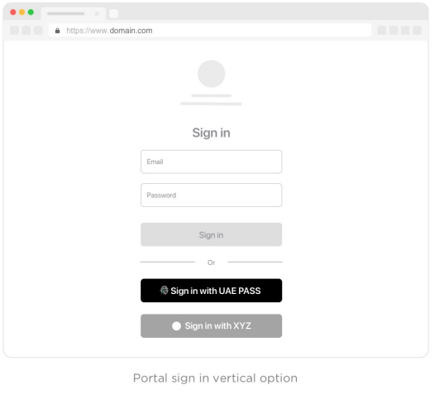
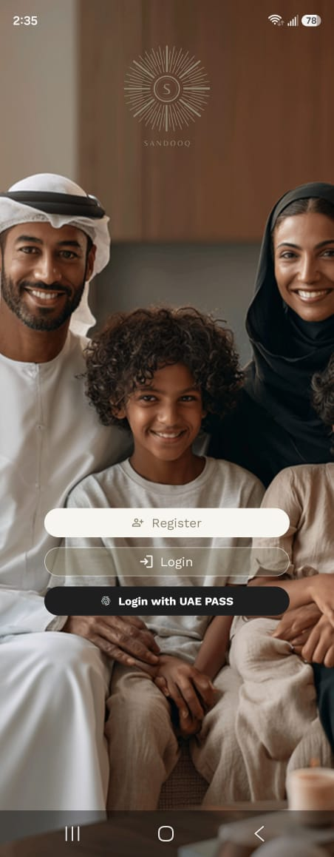
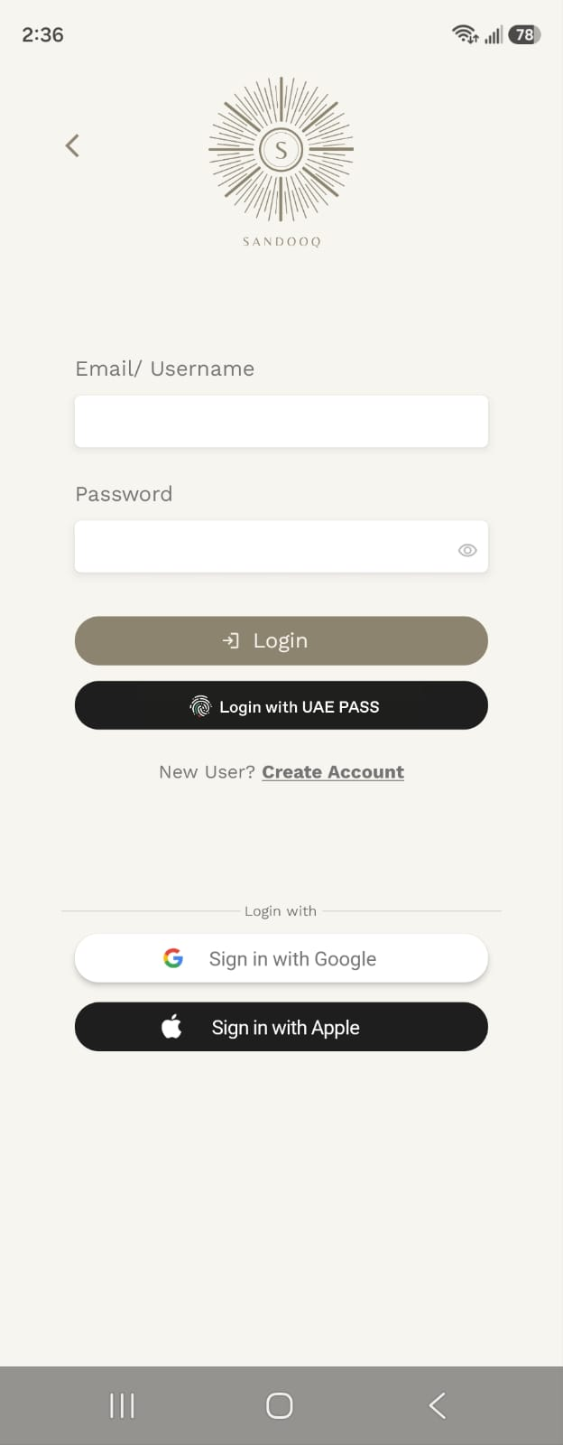
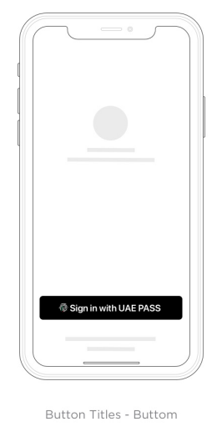
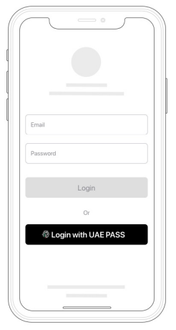
Sign-in with UAE PASS
Welcome and Login screens — “Login with UAE PASS” available on both.

Slide 4
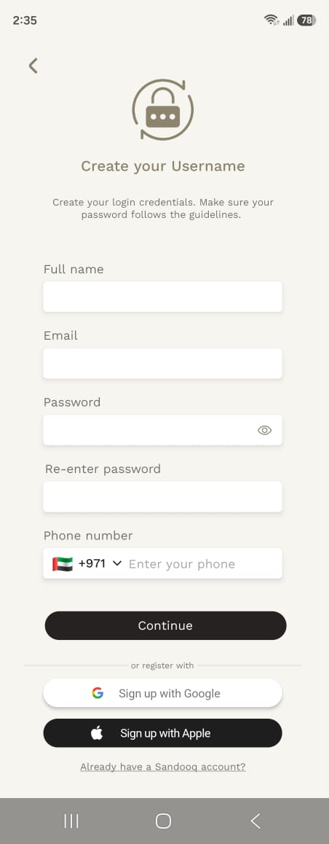
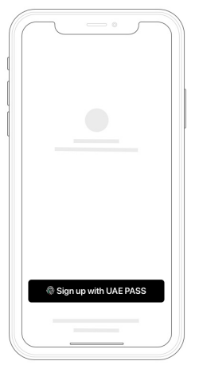
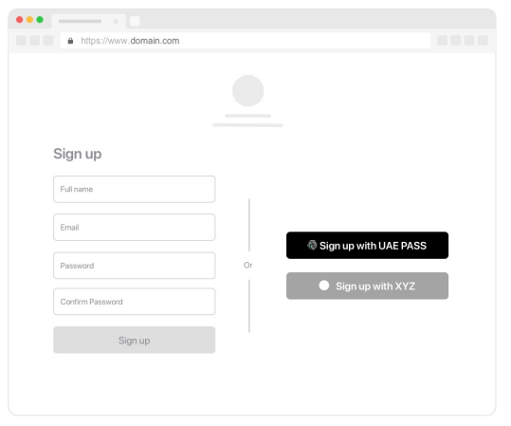
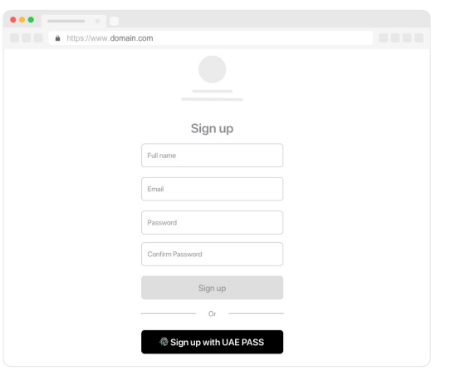
Sign up with UAE PASS (Authentication) If applicable
Sign-up with UAE PASS uses the same “Login with UAE PASS” button on the Welcome/Login screens — new users are auto-registered (see the registration slide).

Slide 5
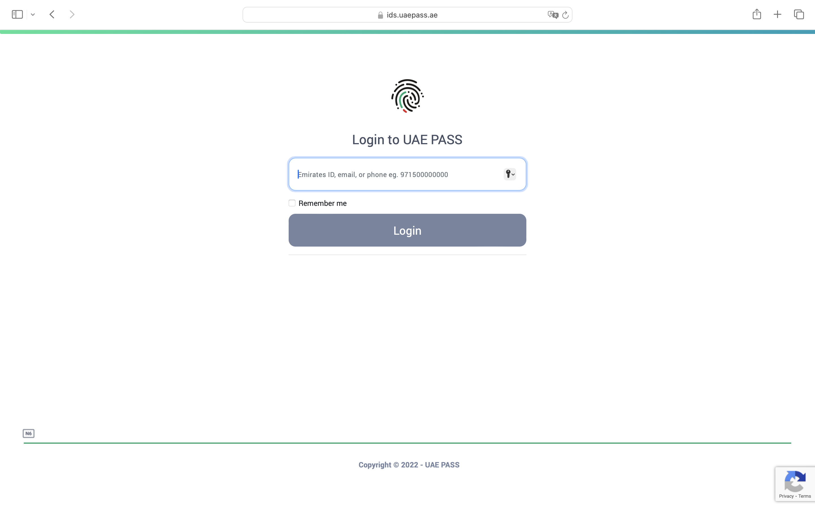
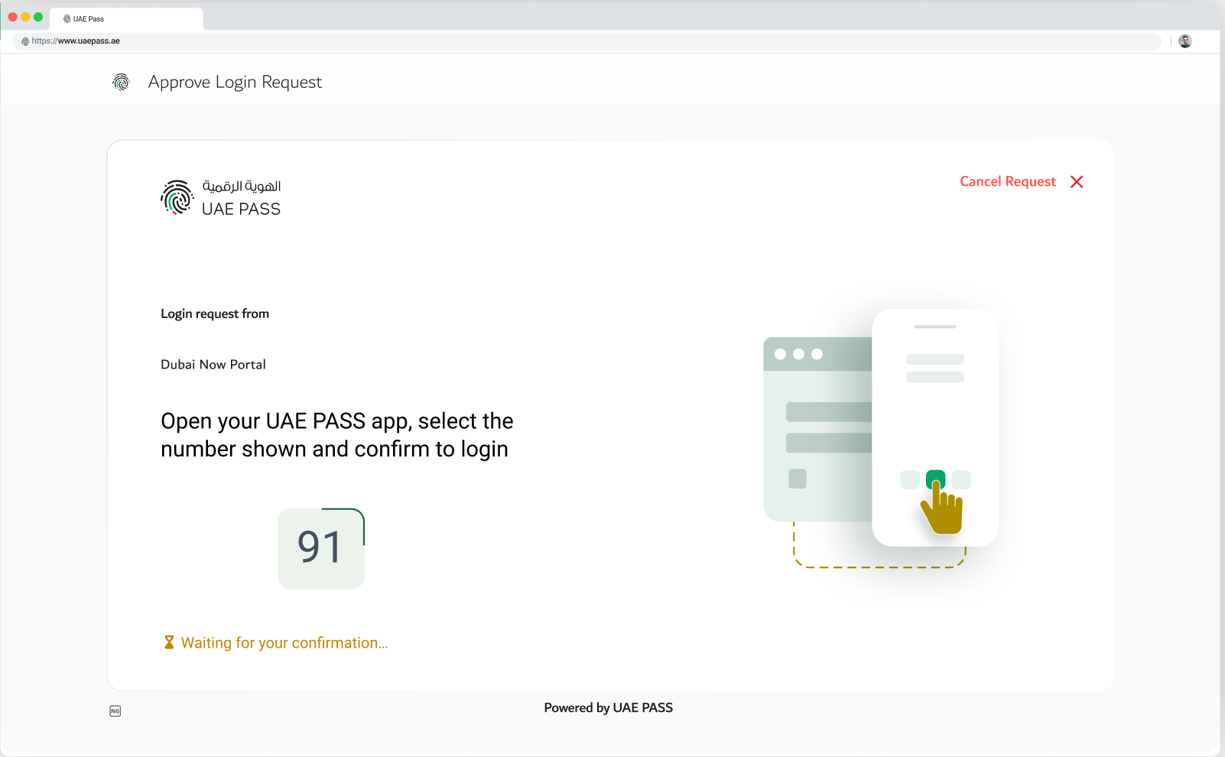
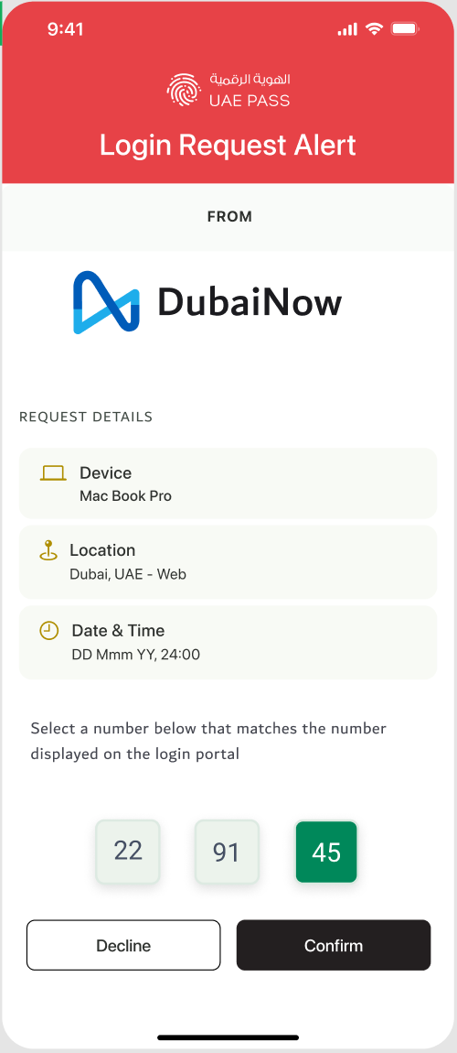
Redirection to UAE PASS Login page (WEB)
NOT APPLICABLE - Sandooq has no web channel (mobile app only; see APP scenario on the next slide)

Slide 6
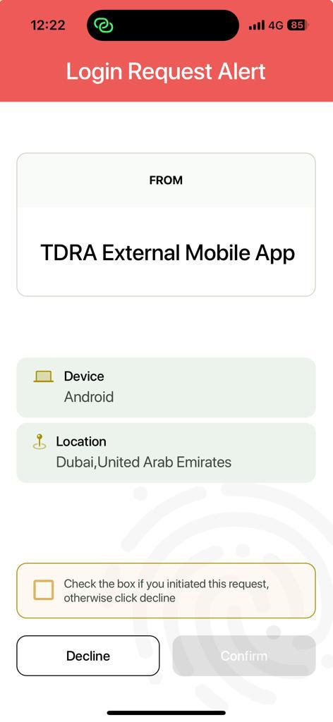
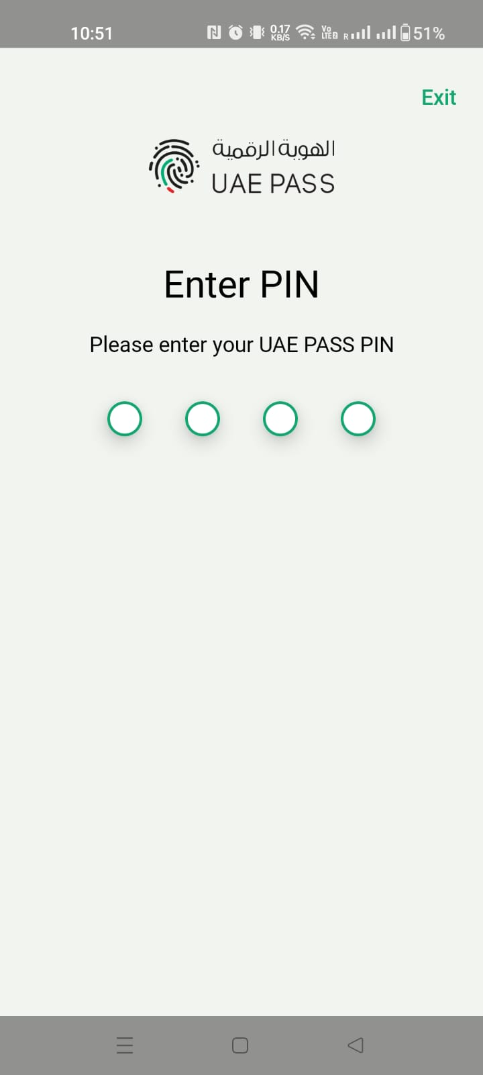
OR Redirection to UAE PASS Login page (App)

Slide 7
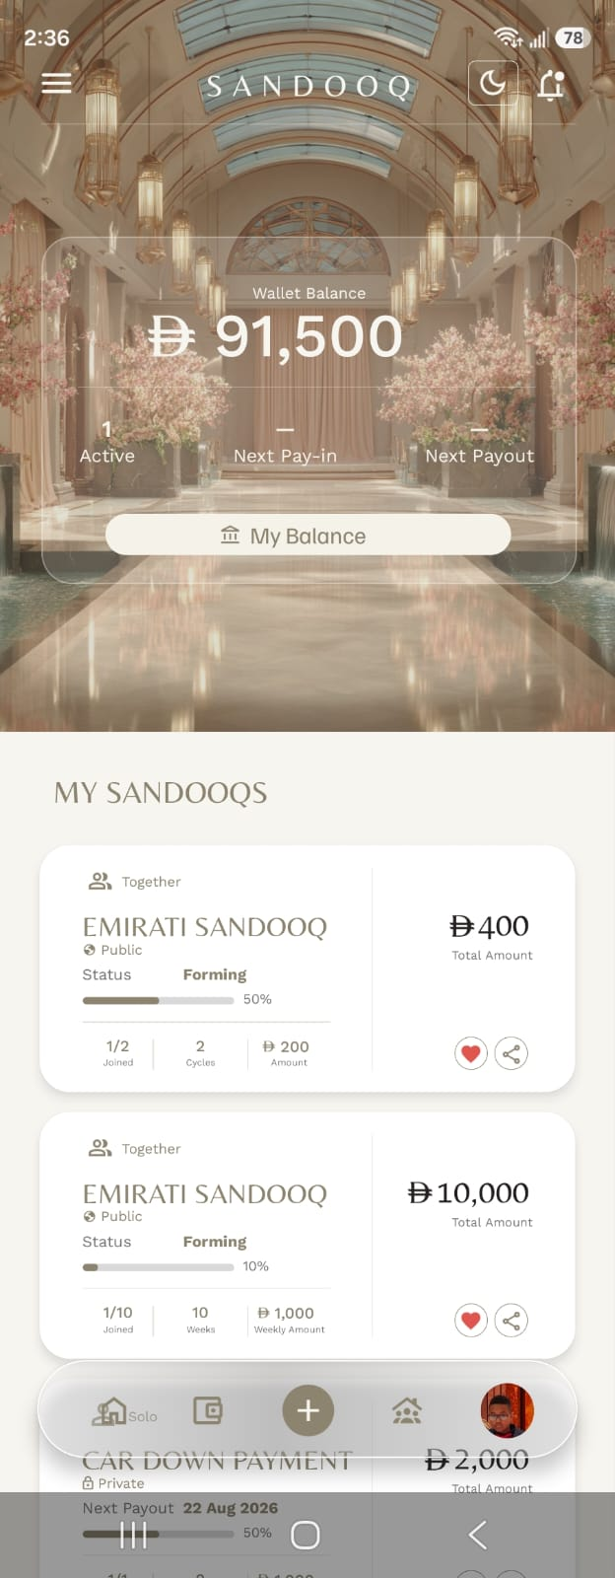
SOP1 scenario (If applicable)
SOP1: signed-in dashboard — standard app access; no Emirates ID attribute is provided or stored.

Slide 8
SOP2 scenario (If applicable)
SOP2: same signed-in experience; the verified Emirates ID number is stored as a verified profile attribute.

Slide 9
SOP3 scenario
SOP3: same signed-in experience; verified attributes (incl. Emirates ID) stored on the profile.

Slide 10
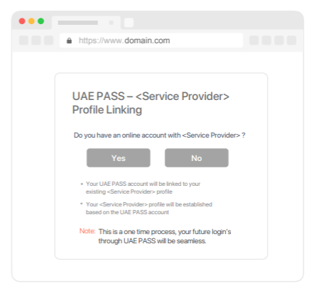
Manual linking page (if applicable)
NOT APPLICABLE - Sandooq uses automatic linking (verified mobile number) + auto-registration; no manual linking page
Please add your prototype into this placeholder

Slide 11
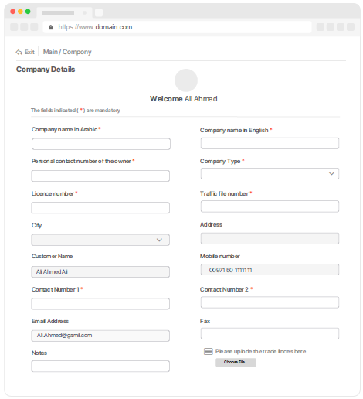
Manual linking (NO) scenario (if applicable)
NOT APPLICABLE - no manual linking flow
Please add your prototype into this placeholder

Slide 12
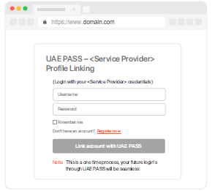
Manual linking (YES) scenario (if applicable)
NOT APPLICABLE - no manual linking flow
Please add your prototype into this placeholder

Slide 13
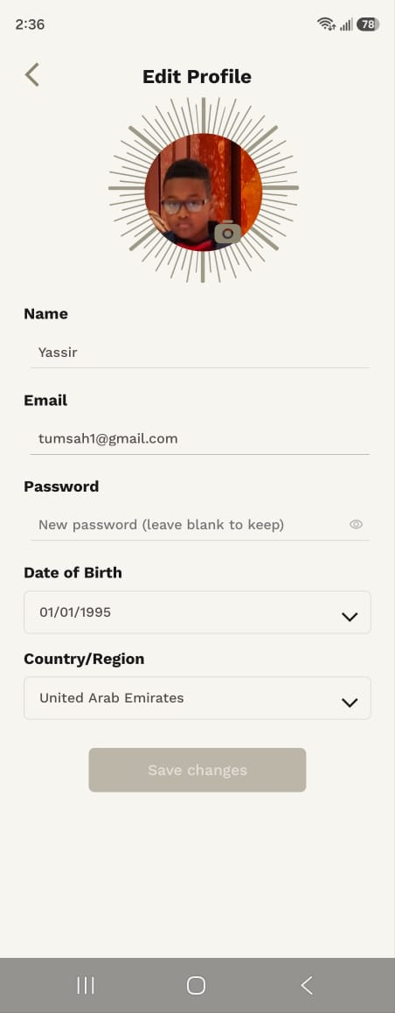
Only registration/Sign up Scenario (If applicable)
New accounts are auto-registered with the profile pre-populated from UAE PASS attributes (name, email, mobile); UAE PASS-sourced fields are locked.

Slide 14
Error Handling
Only existing users error message
This service is only for registered users, please contact <SP Name> in order to access the services
NOT APPLICABLE - new users are auto-registered; the service is not restricted to existing users
Please add your prototype into this placeholder
هذه الخدمة مخصصة فقط للمستخدمين المسجلين، يرجى التواصل مع <اسم الجهة> لتتمكن من الوصول إلى الخدمات

Slide 15
Error Handling
Unverified user restriction
You are not eligible to access this service. Your account is either not upgraded or you have a visitor account. Please contact <SP Name> to access the services.
NOT APPLICABLE - SOP1 (unverified) accounts are permitted with standard app access
Please add your prototype into this placeholder
أنت غير مؤهل للوصول إلى هذه الخدمة. إما أن حسابك لم تتم ترقيته أو لديك حساب زائر. يرجى الاتصال بـ <اسم الجهة> لتتمكن من الوصول إلى الخدمة.

Slide 16
Error Handling
Something went wrong during the login
Something went wrong during the login, please try again later!
حدث خطأ ما أثناء تسجيل الدخول، يرجى المحاولة مرة أخرى لاحقًا!
The mandated message (right) is shown as an in-app alert over the Login screen.

Slide 17
Error Handling
User cancel scenario
User cancelled the login
قام المستخدم بإلغاء تسجيل الدخول
On cancel the user is returned to the Welcome screen; no error is shown.

Slide 18
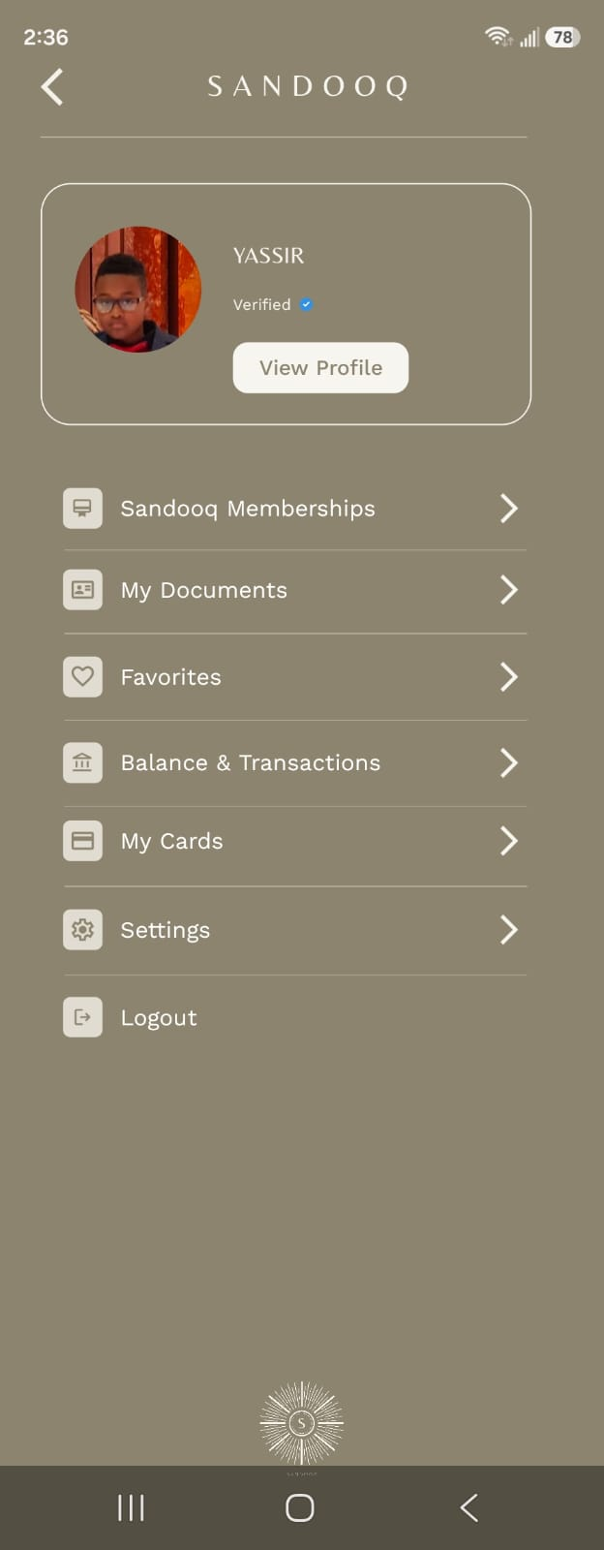
Logout scenario
Menu → Logout clears the Sandooq session; the next sign-in requires UAE PASS authentication again.

Slide 19
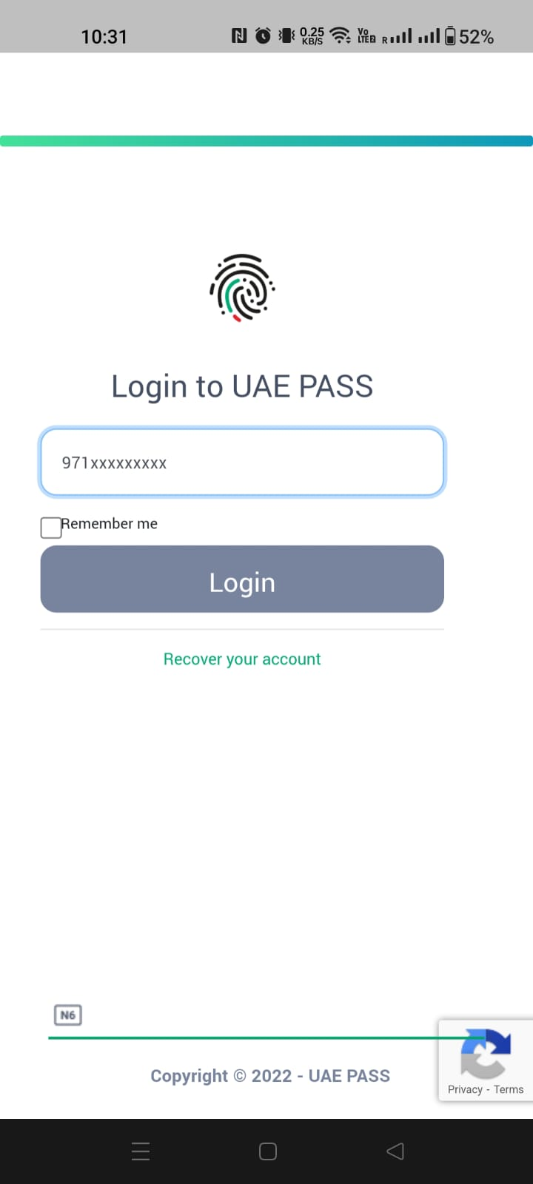
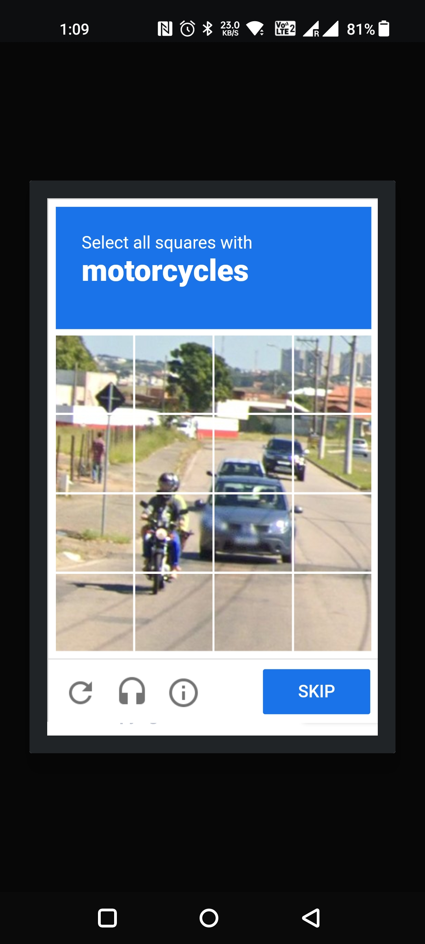
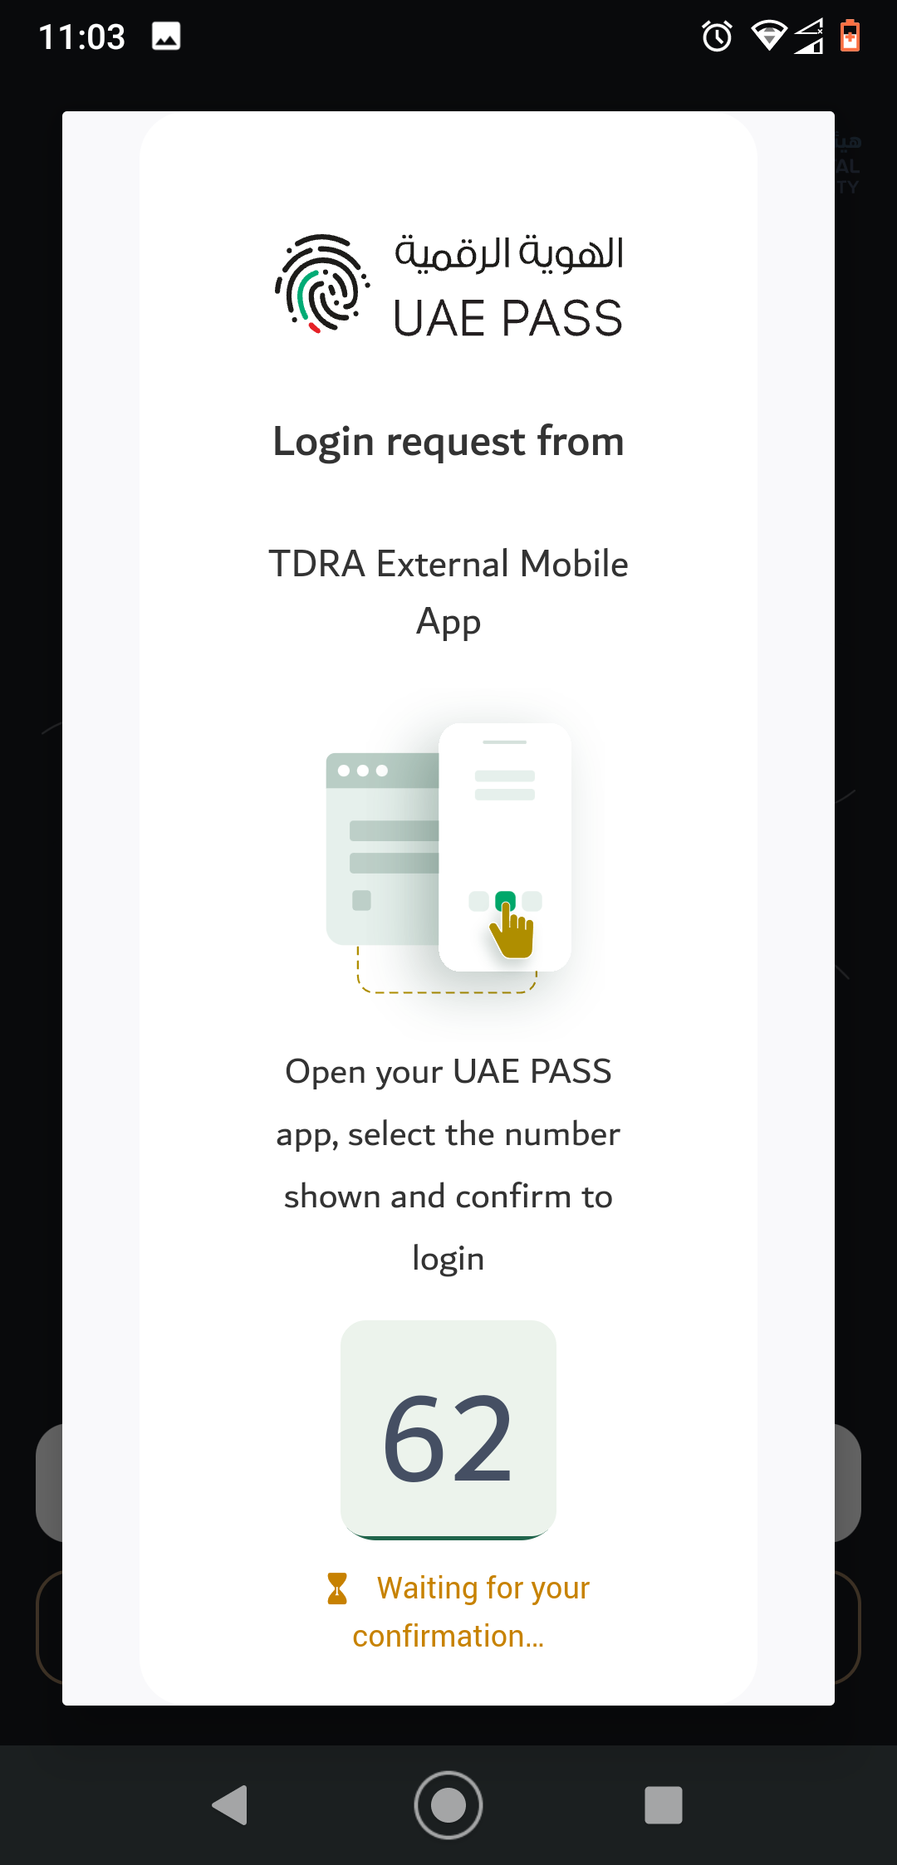
APP to WEB scenario (if mobile integration)
Tapping “Login with UAE PASS” opens the system browser / UAE PASS app (stock flow, right), then control returns to the app.

